Slide 1
UNIT - 5
UNSUPERVISED LEARNING: CLUSTERING AND PATTERN DETECTION

Slide 2
Have you ever spent time watching a large crowd? If so, you are likely to have seen some recurring personalities. Perhaps a certain type of person, identified by a freshly pressed suit and a briefcase, comes to typify the "fat cat" business executive. A twenty-something wearing skinny jeans, a flannel shirt, and sunglasses might be dubbed a "hipster," while a woman unloading children from a minivan may be labeled a "soccer mom.“
Notes:
Unsupervised learning is a type of machine learning in which models are trained using unlabeled dataset and are allowed to act on that data without any supervision.Unsupervised learning cannot be directly applied to a regression or classification problem because unlike supervised learning, we have the input data but no corresponding output data. The goal of unsupervised learning is to find the underlying structure of dataset, group that data according to similarities, and represent that dataset in a compressed format.

Slide 3
Of course, these types of stereotypes are dangerous to apply to individuals, as no two people are exactly alike. Yet understood as a way to describe a collective, the labels capture some underlying aspect of similarity among the individuals within the group.

Slide 4
Clustering
Clustering is an unsupervised machine learning task that automatically divides the data into clusters, or groups of similar items. It does this without having been told how the groups should look ahead of time. As we may not even know what we're looking for, clustering is used for knowledge discovery rather than prediction. It provides an insight into the natural groupings found within data.

Slide 5
Without advance knowledge of what comprises a cluster, how can a computer possibly know where one group ends and another begins? The answer is simple. Clustering is guided by the principle that items inside a cluster should be very similar to each other, but very different from those outside. The definition of similarity might vary across applications, but the basic idea is always the same— group the data so that the related elements are placed together.

Slide 6
The resulting clusters can then be used for action. For instance, you might find clustering methods employed in the following applications:
• Segmenting customers into groups with similar buying patterns for targeted marketing campaigns
• Detecting anomalous behavior, such as unauthorized network intrusions,
• Simplifying extremely large datasets by grouping features with similar values into a smaller number of homogeneous categories

Slide 7
Clustering as a machine Learning Task
Suppose you were organizing a conference on the topic of data science. To facilitate professional networking and collaboration, you planned to seat people in groups according to one of three research specialties: computer and/or database science, math and statistics, and machine learning. Unfortunately, after sending out the conference invitations, you realize that you had forgotten to include a survey asking which discipline the attendee would prefer to be seated with.

Slide 8
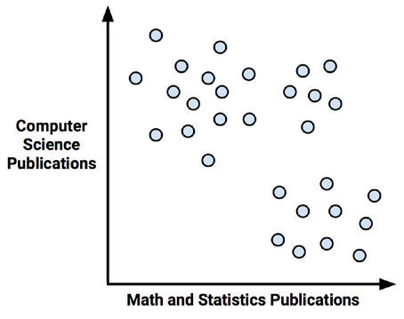

Slide 9
As expected, there seems to be a pattern. We might guess that the upper-left corner, which represents people with many computer science publications but few articles on math, could be a cluster of computer scientists. Following this logic, the lower-right corner might be a group of mathematicians. Similarly, the upper-right corner, those with both math and computer science experience, may be machine learning experts

Slide 10
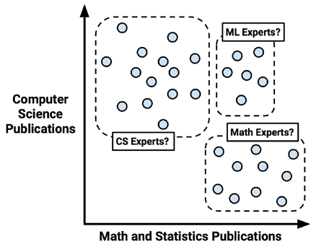

Slide 11
K-Means Clustering Algorithm
The k-means algorithm assigns each of the n examples to one of the k clusters, where k is a number that has been determined ahead of time. The goal is to minimize the differences within each cluster and maximize the differences between the clusters.
The algorithm essentially involves two phases. First, it assigns examples to an initial set of k clusters. Then, it updates the assignments by adjusting the cluster boundaries according to the examples that currently fall into the cluster. The process of updating and assigning occurs several times until changes no longer improve the cluster fit. At this point, the process stops and the clusters are finalized.

Slide 12
Using distance to assign and update cluster
The k-means algorithm begins by choosing k points in the feature space to serve as the cluster centers. These centers are the catalyst that spurs/encourage the remaining examples to fall into place. As we hope to identify three clusters, according to this method, k = 3 points will be selected at random. These points are indicated by the star, triangle, and diamond in the following diagram:

Slide 13
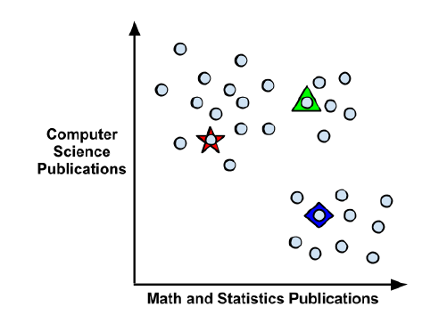

Slide 14
After choosing the initial cluster centers, the other examples are assigned to the cluster center that is nearest according to the distance function.
As shown in the following diagram, the three cluster centers partition the examples into three segments labeled Cluster A, Cluster B, and Cluster C. The dashed lines indicate the boundaries for the Voronoi diagram created by the cluster centers. The Voronoi diagram indicates the areas that are closer to one cluster center than any other; the vertex where all the three boundaries meet is the maximal distance from all three cluster centers. Using these boundaries, we can easily see the regions claimed by each of the initial k-means seeds:

Slide 15
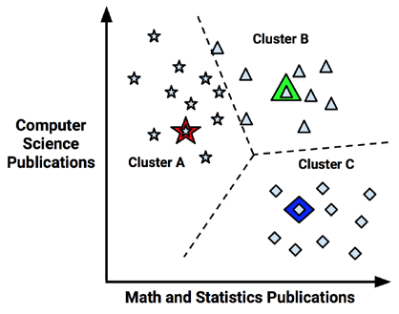

Slide 16
Now that the initial assignment phase has been completed, the k-means algorithm proceeds to the update phase. The first step of updating the clusters involves shifting the initial centers to a new location, known as the centroid, which is calculated as the average position of the points currently assigned to that cluster. The following diagram illustrates how as the cluster centers shift to the new centroids, the boundaries in the Voronoi diagram also shift and a point that was once in Cluster B (indicated by an arrow) is added to Cluster A:

Slide 17
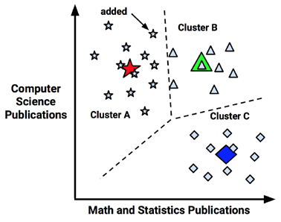

Slide 18
As a result of this reassignment, the k-means algorithm will continue through another update phase. After shifting the cluster centroids, updating the cluster boundaries, and reassigning points into new clusters (as indicated by arrows), the figure looks like this:

Slide 19
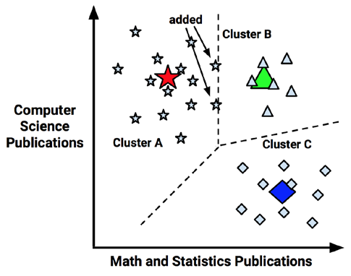

Slide 20
Because two more points were reassigned, another update must occur, which moves the centroids and updates the cluster boundaries. However, because these changes result in no reassignments, the k-means algorithm stops. The cluster assignments are now final:

Slide 21
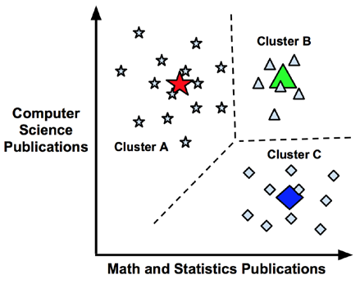

Slide 22
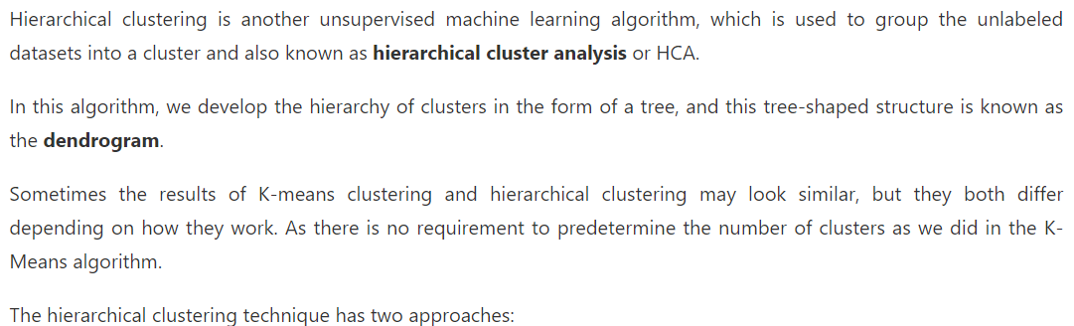
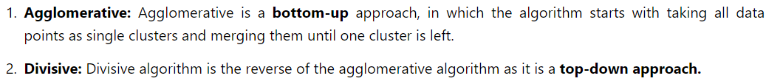
Hierarchical Clustering in Machine Learning
Notes:
As we already have other clustering algorithms such as K-Means Clustering, then why we need hierarchical clustering? So, as we have seen in the K-means clustering that there are some challenges with this algorithm, which are a predetermined number of clusters, and it always tries to create the clusters of the same size. To solve these two challenges, we can opt for the hierarchical clustering algorithm because, in this algorithm, we don't need to have knowledge about the predefined number of clusters.

Slide 23
